Slide 1

Welcome to the DTP Core Skills – Maths, Programming and Scientific Computing

Slide 2
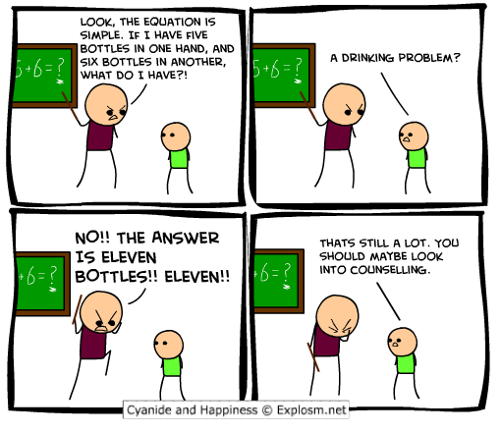
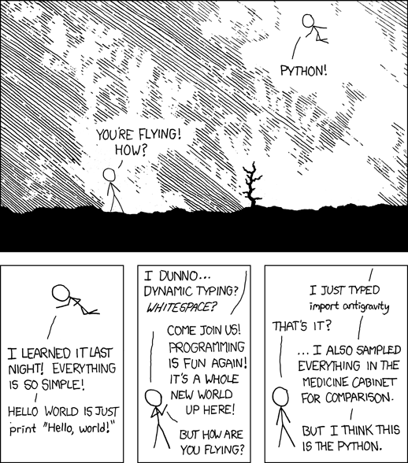
Maths, programming and statistics? Oh god why?

Slide 3
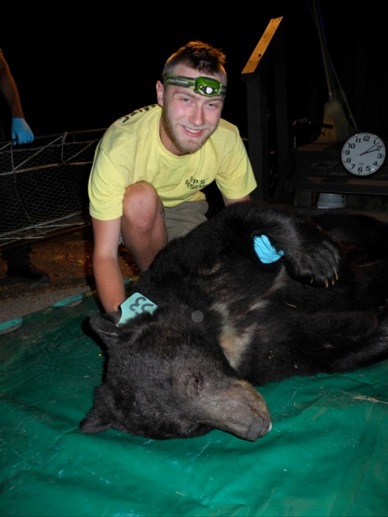

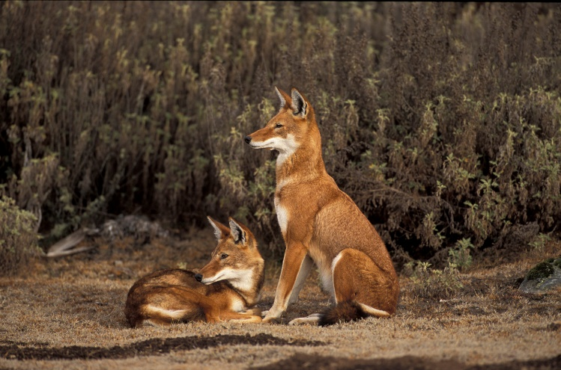

About Me
James Foley
DPhil Candidate Zoology
Any problems you have, comments, suggestions or if you just want to chat shoot me an email at : james.foley@zoo.ox.ac.uk
3

Slide 4
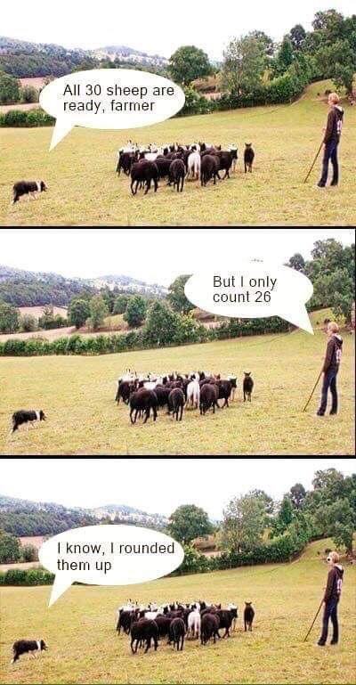
About you?
GCSE / A level / Equivalent?
Any programming languages?
Statistics for previous projects?

Slide 5
What this course will cover: Maths
Basics of math’s refresher.
Algebra, equations and functions.
Trigonometry and circles.
Calculus, calculus and more calculus.

Slide 6
What this course will cover: Programming
Basics of Programming taught by Dr Lucy Talents
Python – one of the most popular and easy to use programming languages.
R – a widely used programming langauge similar to python with high level of support for statistics and science.

Slide 7
What this course will cover: Scientific Computing
Understanding data, power, experimental design and the maths behind statistics.
Basic statistical tests up to linear models and GLMs
Using Python for more complicated mathematical purposes – learn how modelling works!

Slide 8
Don’t
Panic

Slide 9
Math's
BODMAS, algebra, factorising and formulae

Slide 10
Testing what you know
4² + (21 – 3) x 13 – 144/12 = ??

Slide 11
Testing what you know
4² + (21 – 3) x 13 – 144/12 = ??
BODMAS

Slide 12
Testing what you know
4² + (21 – 3) x 13 – 144/12 = ??
B O D M A S
Brackets Orders Division Multiply Addition Subtraction

Slide 13
Testing what you know
4² + (21 – 3) x 13 – 144/12 = ??
B O D M A S
Brackets Orders Division Multiply Addition Subtraction

Slide 14
Testing what you know
4² + 18 x 13 – 144/12 = ??
B O D M A S
Brackets Orders Division Multiply Addition Subtraction

Slide 15
Testing what you know
4² + 18 x 13 – 144/12 = ??
B O D M A S
Brackets Orders Division Multiply Addition Subtraction

Slide 16
Testing what you know
16 + 18 x 13 – 144/12 = ??
B O D M A S
Brackets Orders Division Multiply Addition Subtraction

Slide 17
Testing what you know
16 + 18 x 13 – 144/12 = ??
B O D M A S
Brackets Orders Division Multiply Addition Subtraction

Slide 18
Testing what you know
16 + 18 x 13 – 12 = ??
B O D M A S
Brackets Orders Division Multiply Addition Subtraction

Slide 19
Testing what you know
16 + 18 x 13 – 12 = ??
B O D M A S
Brackets Orders Division Multiply Addition Subtraction

Slide 20
Testing what you know
16 + 234 – 12 = ??
B O D M A S
Brackets Orders Division Multiply Addition Subtraction

Slide 21
Testing what you know
16 + 234 – 12 = ??
B O D M A S
Brackets Orders Division Multiply Addition Subtraction

Slide 22
Testing what you know
250 – 12 = ??
B O D M A S
Brackets Orders Division Multiply Addition Subtraction

Slide 23
Testing what you know
250 – 12 = ??
B O D M A S
Brackets Orders Division Multiply Addition Subtraction

Slide 24
Testing what you know
250 – 12 = 238
B O D M A S
Brackets Orders Division Multiply Addition Subtraction

Slide 25
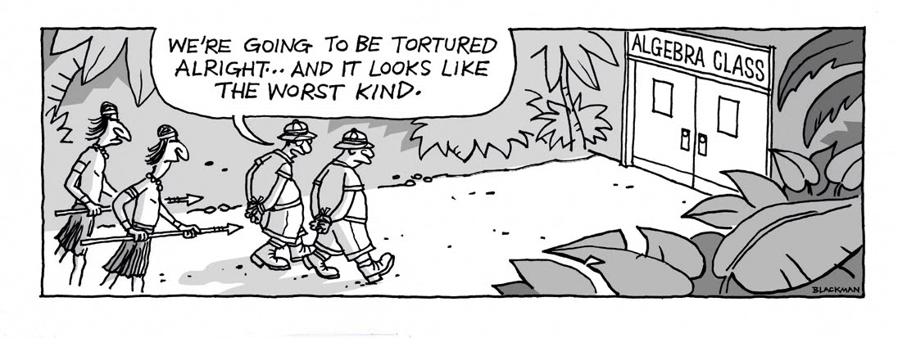
Algebra
At some point people decided that numbers are just not good enough. Thus Algebra was born.
Algebra is fundamentally the ability to represent anything mathematically.
Simply representing an unknown constant such as x as a number e.g. x = 3 . But this is the basis of nearly all maths and science

Slide 26
Simplify the Equation
x – 4 = 16

Slide 27
Simplify the Equation
x – 4 = 16
The goal is to have x = ?
Simplifying to the most basic definition of x that can be gained

Slide 28
Simplify the Equation
x – 4 = 16
To do this do this we must simplify each side by doing the same thing to both.

Slide 29
Simplify the Equation
+ 4
+ 4
x – 4 = 16
To do this do this we must simplify each side by doing the same thing to both. we have to do the same thing to both sides because of the equals sign, we need to keep both sides equal

Slide 30
Simplify the Equation
x – 4 + 4 = 16 + 4
You can probably do this one in your head

Slide 31
Simplify the Equation
x = 20
Et voila we have a simplified equation. Hopefully without too many flashbacks to school.

Slide 32
Simplify the Equation
5x = 25
The same principles apply with other simplification. Here we see multiplication

Slide 33
Simplify the Equation
5x / 5 = 25 / 5
Divide both sides by 5

Slide 34
Simplify the Equation
x = 5
And we have the answer

Slide 35
Simplify the Equation
x² = 25
And here we see a power.

Slide 36
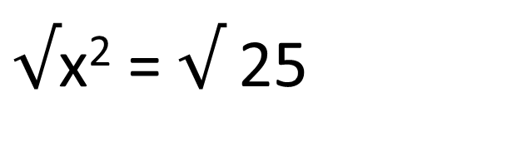
Simplify the Equation
$√$x² = $√$25
Square root both sides

Slide 37
Simplify the Equation
x = 5
Easy as pi!

Slide 38
Simplify the Equation
x = 5 or…..
Easy as pi!

Slide 39
Simplify the Equation
x = -5
Easy as pi!

Slide 40
Lets get a bit more complicated
3x + 14 – (12 x 4) / 6 = 14 + 19

Slide 41
Lets get a bit more complicated
3x + 14 – (12 x 4) / 6 = 14 + 19
Remember your BODMAS – this will make things easier to simplify.

Slide 42
Lets get a bit more complicated
3x + 14 – 48 / 6 = 14 + 19
Brackets!

Slide 43
Lets get a bit more complicated
3x + 14 – 8 = 14 + 19
Division!

Slide 44
Lets get a bit more complicated
3x + 14 – 8 = 14 + 19
In this case 3x means 3 * x so the multiplication has been done

Slide 45
Lets get a bit more complicated
3x + 14 – 8 = 33
Addition

Slide 46
Lets get a bit more complicated
3x + 6 = 33
Subtraction

Slide 47
Lets get a bit more complicated
3x + 6 = 33
Now we have an equation that can be simplified.

Slide 48
Lets get a bit more complicated
3x + 6 = 33
- 6 from both sides and divide by 3.

Slide 49
Lets get a bit more complicated
3x = 27
- 6 from both sides and divide by 3.

Slide 50
Lets get a bit more complicated
x = 9
- 6 from both sides and divide by 3.

Slide 51
Lets get a bit more complicated
3x + 6 = 33
Note if you divide by 3 first then – the remainder you still get the same answer.

Slide 52
Lets get a bit more complicated
x + 2 = 11
Note if you divide by 3 first then – the remainder you still get the same answer.

Slide 53
Lets get a bit more complicated
x = 9
Note if you divide by 3 first then – the remainder you still get the same answer.

Slide 54
You can have multiple x statements in an equation
4x + 2(x – 6) = 9 + 3x
Lots of x’s!

Slide 55
You can have multiple x statements in an equation
4x + 2(x – 6) = 9 + 3x
Even though 4x is a multiplication it can be added or subtracted to other x values. 3 x 3 = 9 however 3 x 3 + 3 x 3 = 9 + 9 = 18 the same as 6 x 3.

Slide 56
You can have multiple x statements in an equation
4x + 2(x – 6) = 9 + 3x
Lets use our BODMAS

Slide 57
You can have multiple x statements in an equation
4x + 2x – 12 = 9 + 3x
Lets use our BODMAS

Slide 58
You can have multiple x statements in an equation
4x + 2x – 12 = 9 + 3x
OK now we simplify the x’s we can do

Slide 59
You can have multiple x statements in an equation
6x – 12 = 9 + 3x
OK now we simplify the x’s we can do

Slide 60
You can have multiple x statements in an equation
6x – 12 = 9 + 3x
And just get all the x’s on one side and numbers on the other.

Slide 61
You can have multiple x statements in an equation
6x – 3x – 12 + 12 = 9 + 3x – 3x + 12
And just get all the x’s on one side and numbers on the other.

Slide 62
You can have multiple x statements in an equation
3x = 21
Finally divide by 3

Slide 63
You can have multiple x statements in an equation
x = 7
Finally divide by 3

Slide 64
Expanding brackets
Sometimes you have algebraic expressions with double brackets or a bracket is squared and we want to get them out to simplify it.
(x + y)²
To approach double brackets we have to follow a certain procedure.

Slide 65
Expanding brackets
(x + y)²
( x + y )²
( x + y )²
( x + y )²

Slide 66
Expanding brackets
(x + y)²
( x + y )²
( x + y )²
( x + y )²

Slide 67
Expanding brackets
(x + y)²
( x + y )²
( x + y )²
( x + y )²

Slide 68
Expanding brackets
(x + y)²
( x + y )²
( x + y )²
( x + y )²

Slide 69
Expanding brackets
(x + y)²
( x + y )²
( x + y )²
( x + y )²
If Only…

Slide 70
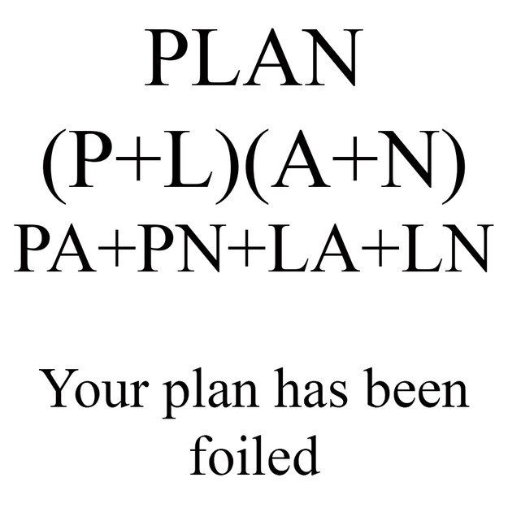
FOIL
F – first
O – outer
I – inner
L - Last
(x + y)² = (x + y)(x + y)

Slide 71
FOIL
F – first
O – outer
I – inner
L - Last
(x + y)(x + y)

Slide 72
FOIL
F – first
O – outer
I – inner
L - Last
(x + y)(x + y) =
x² + + +

Slide 73
FOIL
F – first
O – outer
I – inner
L - Last
(x + y)(x + y) =
x² + xy + +

Slide 74
FOIL
F – first
O – outer
I – inner
L - Last
(x + y)(x + y) =
x² + xy + xy +

Slide 75
FOIL
F – first
O – outer
I – inner
L - Last
(x + y)(x + y) =
x² + xy + xy +

Slide 76
FOIL
F – first
O – outer
I – inner
L - Last
(x + y)(x + y) =
x² + xy + xy + y ²

Slide 77
FOIL
F – first
O – outer
I – inner
L - Last
(x + y)(x + y) = x² + 2xy + y²

Slide 78
FOILed again
F – first
O – outer
I – inner
L - Last
(2x + 3)(x – 1)

Slide 79
FOILed again
F – first
(2x + 3)(x – 1) =
2x * x + + +

Slide 80
FOILed again
O - Outer
(2x + 3)(x – 1) =
2x * x + 2x * -1 + +
Remember when breaking these things up the operator sticks to the number after it so x – 1 is -1 brought out.

Slide 81
FOILed again
I – Inner
(2x + 3)(x – 1) =
2x * x + 2x * -1 + 3 * x +

Slide 82
FOILed again
L – Last
(2x + 3)(x – 1) =
2x * x + 2x * -1 + 3 * x + 3 * -1

Slide 83
FOILed again
(2x + 3)(x – 1) = 2x² + x - 3

Slide 84
Factorising
Sometimes what we have is an expanded equation and what we want is a more simple solution in brackets.
This is a critical step in the solving of quadratic equations that we will come to later.
10 + 4x

Slide 85
Factorising
10 + 4x
Find the highest common factor that goes into this. Here it looks like it would be 2. This is what comes before the bracket.

Slide 86
Factorising
10 + 4x
Find the highest common factor that goes into this. Here it looks like it would be 2. This is what comes before the bracket.
2( )

Slide 87
Factorising
10 + 4x
Now we put what is left in the bracket. What x 2 = 10? And what x2 = 4x?
2(5 + 2x)

Slide 88
Factorising
20x² – 5x
Find the highest common factor

Slide 89
Factorising
20x² – 5x
5x( )
Now what * 5x goes into the bracket?

Slide 90
Factorising
20x² – 5x
5x(4x – 1)

Slide 91
Factorising with squares
Remember FOIL
(x – y)(x + y)
=x² + xy – xy + y²
=x² + y²

Slide 92
Factorising with squares
Remember FOIL
(x – y)(x + y)
=x² + xy – xy + y²
=x² + y²

Slide 93
Factorising with squares
Remember FOIL
(x – y)(x + y)
=x² + xy – xy + y²
=x² + y²

Slide 94
Factorising with squares
Remember FOIL
(x – y)(x + y)
=x² + xy – xy - y²
=x² - y²
This is the difference between two squares.

Slide 95
Factorising with squares
Lets reverse it
x² – 16
When factorising, keep your eyes open for squares.
(x)² – (4)²

Slide 96
Factorising with squares
(x)² – (4)²
From our expanding of brackets we know that factorising the difference of two squares is:
(x – 4)(x + 4)

Slide 97
Factorising with squares
How about
36x² – 49y²

Slide 98
Factorising with squares
How about
36x² – 49y²
(6x)² – (7y)²

Slide 99
Factorising with squares
How about
36x² – 49y²
(6x)² – (7y)²
(6x – 7y)(6x + 7y)

Slide 100
Factorising trinomials
This is a fancy way of saying factorising an expression into two brackets. The reverse of our starting FOIL but not just squares.
When the expressions come out of brackets they have the form:
ax² + bx + c
Remember (2x + 3)(x – 1) = 2x² + x - 3

Slide 101
Factorising trinomials
Lets take a look at this equation
x² + 7x + 12

Slide 102
Factorising trinomials
Lets take a look at this equation
x² + 7x + 12
First look for the numbers that multiply together to make 12

Slide 103
Factorising trinomials
Lets take a look at this equation
x² + 7x + 12
First look for the numbers that multiply together to make 12

Slide 104
Factorising trinomials
Lets take a look at this equation
x² + 7x + 12
First look for the numbers that multiply together to make 12
1 x 12
3 x 4
2 x 6

Slide 105
Factorising trinomials
Lets take a look at this equation
x² + 7x + 12
Which of these factors added together equals 7?
1 x 12
3 x 4
2 x 6

Slide 106
Factorising trinomials
Lets take a look at this equation
x² + 7x + 12
Which of these factors added together equals 7?
1 x 12
3 x 4
2 x 6

Slide 107
Factorising trinomials
Lets take a look at this equation
x² + 7x + 12
So the answer to this equation is:
(x + 3)(x + 4)

Slide 108
Factorising trinomials
Now do this one
x² + x - 30

Slide 109
Factorising trinomials
Now do this one
x² + x – 30
Factors: 5 x 6

Slide 110
Factorising trinomials
Now do this one
x² + x – 30
Factors: 5 x 6
(x – 5)(x + 6)

Slide 111
Factorising trinomials
In the cases when the first term coefficient is larger than 1
3x² – 7x – 6
In this case we look for the factors of 3 x -6 that add up to give -7

Slide 112
Factorising trinomials
In the cases when the first term coefficient is larger than 1
3x² – 7x – 6
3 x -6 = -18
Looking for factors of -18 that add up to - 7

Slide 113
Factorising trinomials
In the cases when the first term coefficient is larger than 1
3x² – 7x – 6
3 x -6 = -18
Looking for factors of -18 that add up to – 7
Looks like the factors are 2 and -9

Slide 114
Factorising trinomials
In the cases when the first term coefficient is larger than 1
3x² – 7x – 6
3 x -6 = -18
Looking for factors of -18 that add up to – 7
Looks like the factors are 2 and -9
3x² – 9x + 2x – 6

Slide 115
Factorising trinomials
In the cases when the first term coefficient is larger than 1
3x² – 7x – 6
3x² – 9x + 2x – 6
Looks like there are some common factors here – take them out

Slide 116
Factorising trinomials
In the cases when the first term coefficient is larger than 1
3x² – 7x – 6
3x² – 9x + 2x – 6
Looks like there are some common factors here – take them out
3x(x – 3) + 2(x – 3)

Slide 117
Factorising trinomials
In the cases when the first term coefficient is larger than 1
3x² – 7x – 6
3x² – 9x + 2x – 6
3x(x – 3) + 2(x – 3)
We now have 2 brackets the same. So what this becomes is:
(x – 3)(3x + 2)

Slide 118
Completing the square
Sometimes we want to convert a quadratic equation like we just saw of the form:
ax² + bx + c
Into
a(x – h)² + k
Wait where did these come from??

Slide 119
Completing the square
Sometimes we want to convert a quadratic equation like we just saw of the form:
ax² + bx + c
Into
a(x – h)² + k
These are just new values that we will pull out as we solve

Slide 120
Completing the square
ax² + bx + c → a(x – h)² + k
x² – 6x + 11
First we find h by working out b/2

Slide 121
Completing the square
ax² + bx + c → a(x – h)² + k
x² – 6x + 11
First we find h by working out b/2
(x – 3)² + k

Slide 122
Completing the square
ax² + bx + c → a(x – h)² + k
x² – 6x + 11
(x – 3)² + k
So if we expand (x – 3)(x – 3)

Slide 123
Completing the square
ax² + bx + c → a(x – h)² + k
x² – 6x + 11
(x – 3)² + k
So if we expand (x – 3)(x – 3)
x² – 3x – 3x + 9
x² – 6x + 9

Slide 124
Completing the square
ax² + bx + c → a(x – h)² + k
x² – 6x + 11
(x – 3)² + k
So if we expand (x – 3)(x – 3)
x² – 3x – 3x + 9
x² – 6x + 9
Yay this matches!

Slide 125
Completing the square
ax² + bx + c → a(x – h)² + k
x² – 6x + 11
(x – 3)² + k
So if we expand (x – 3)(x – 3)
x² – 3x – 3x + 9
x² – 6x + 9
Damn we’ve gained 9 Better lose it!

Slide 126
Completing the square
ax² + bx + c → a(x – h)² + k
x² – 6x + 11
K is equal to the amount you remove from the expanding add c
(x – 3)² – 9 + 11

Slide 127
Completing the square
ax² + bx + c → a(x – h)² + k
x² – 6x + 11
And done
(x – 3)² + 2

Slide 128
Completing the square
Now you do one
x² + 8x – 3

Slide 129
Completing the square
Now you do one
x² + 8x – 3
(x + 4)² + k

Slide 130
Completing the square
Now you do one
x² + 8x – 3
(x + 4)² + 19

Slide 131
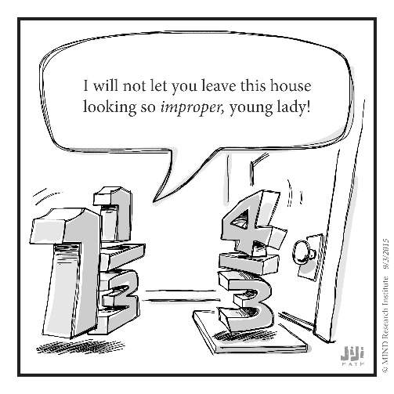
Algebraic Fractions
Algebraic fractions are just fractions with algebraic expressions either on the top or bottom.
When dealing with them we use all the rules we’ve learned and standard fraction rules.
Find the common factor and divide it throughout

Slide 132

Algebraic Fractions
Normal Fractions
$\frac{6}{10}$ = $\frac{6/2}{10/2}$ = $\frac{3}{5}$
Divide everything by lowest common denominator in this case 2

Slide 133

Algebraic Fractions
Algebraic Fractions
$\frac{6x^{2}}{3x}$ =$\frac{6x^{2}/3x}{3x/3x}$ = 2x
Divide everything by highest common factor in this case 3x

Slide 134

Algebraic Fractions
Sometimes it is not obvious what is the factor until we simplify
$\frac{2x+4}{2x}$ =$\frac{2(x+2)}{2x}$ = 2x
First we factorise

Slide 135
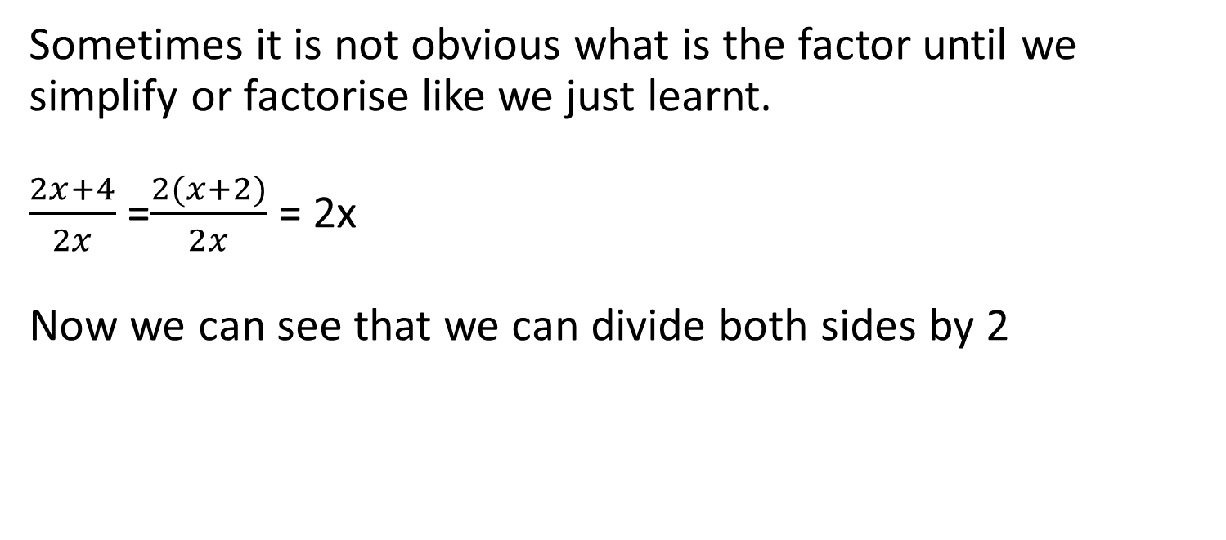
Algebraic Fractions
Sometimes it is not obvious what is the factor until we simplify or factorise like we just learnt.
$\frac{2x+4}{2x}$ =$\frac{2(x+2)}{2x}$ = 2x
Now we can see that we can divide both sides by 2

Slide 136
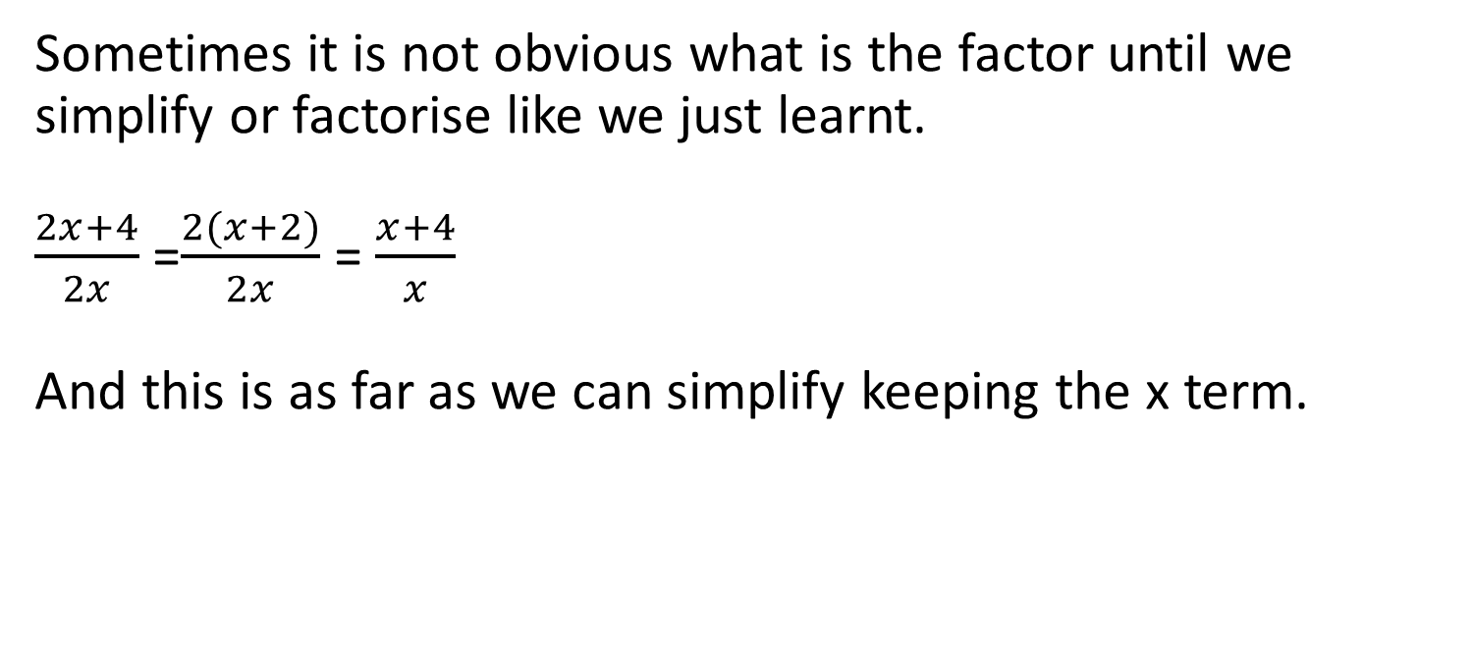
Algebraic Fractions
Sometimes it is not obvious what is the factor until we simplify or factorise like we just learnt.
$\frac{2x+4}{2x}$ =$\frac{2(x+2)}{2x}$ = $\frac{x+4}{x}$
And this is as far as we can simplify keeping the x term.

Slide 137

Algebraic Fractions
As with regular fractions sometimes you have to add or subtract them.
$\frac{2}{x}$ + $\frac{4}{x}$ = $\frac{6}{x}$

Slide 138

Algebraic Fractions
Like with normal fractions you need to find the lowest common denominator
$\frac{2}{5x}$ + $\frac{4}{7x}$ =

Slide 139
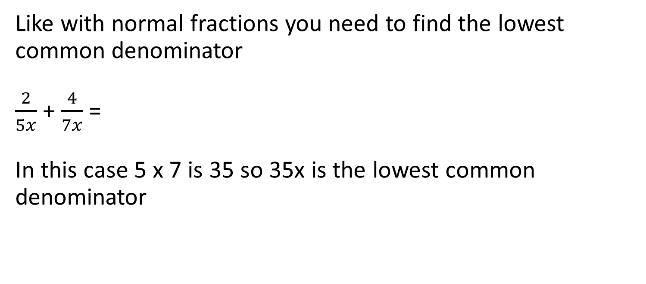
Algebraic Fractions
Like with normal fractions you need to find the lowest common denominator
$\frac{2}{5x}$ + $\frac{4}{7x}$ =
In this case 5 x 7 is 35 so 35x is the lowest common denominator

Slide 140
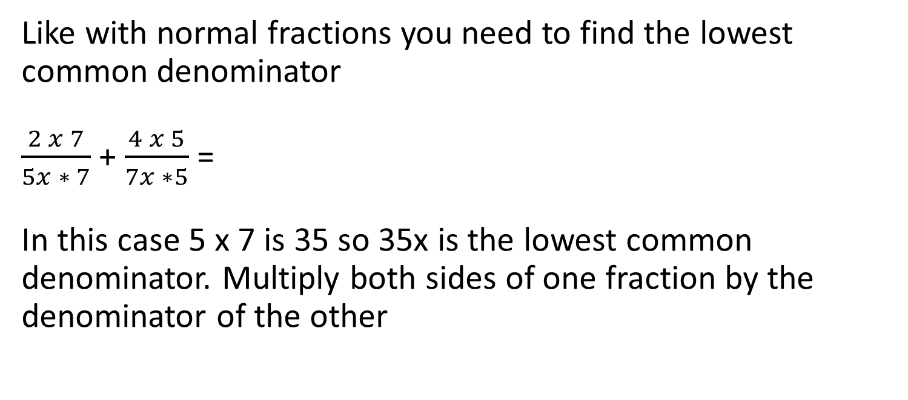
Algebraic Fractions
Like with normal fractions you need to find the lowest common denominator
$\frac{2 x 7}{5x ∗ 7}$ + $\frac{4 x 5}{7x ∗5}$ =
In this case 5 x 7 is 35 so 35x is the lowest common denominator. Multiply both sides of one fraction by the denominator of the other

Slide 141
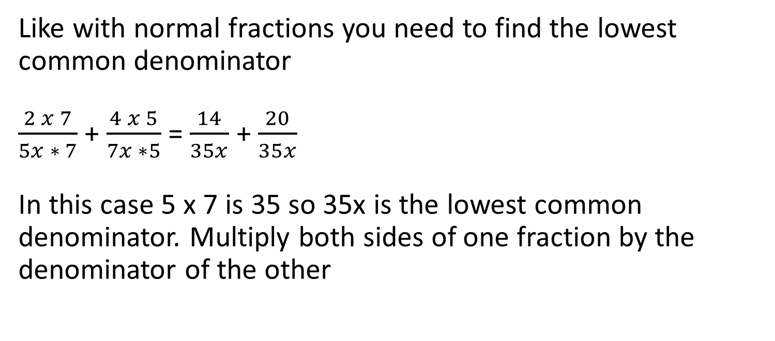
Algebraic Fractions
Like with normal fractions you need to find the lowest common denominator
$\frac{2 x 7}{5x ∗ 7}$ + $\frac{4 x 5}{7x ∗5}$ = $\frac{14}{35x}$ + $\frac{20}{35x}$
In this case 5 x 7 is 35 so 35x is the lowest common denominator. Multiply both sides of one fraction by the denominator of the other

Slide 142
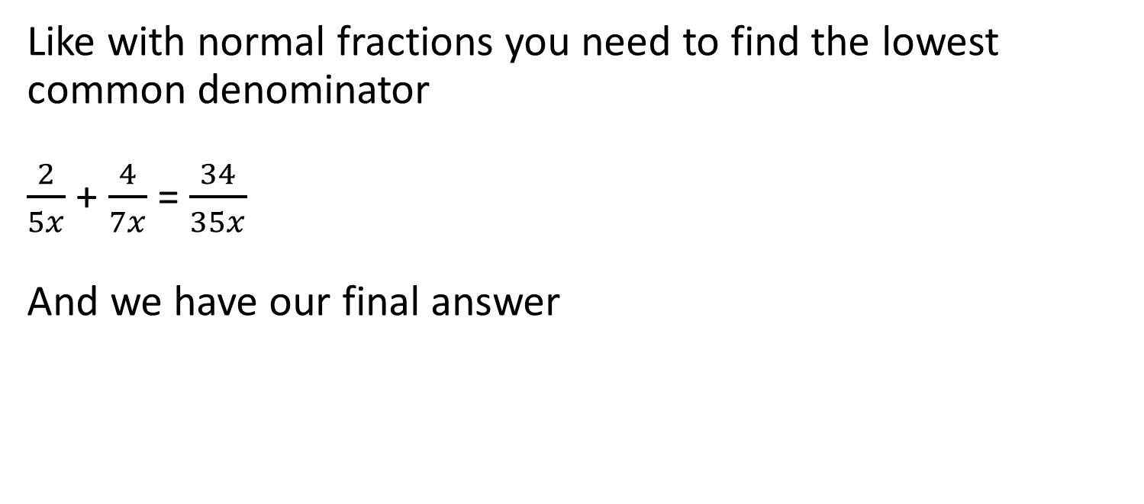
Algebraic Fractions
Like with normal fractions you need to find the lowest common denominator
$\frac{2}{5x}$ + $\frac{4}{7x}$ = $\frac{34}{35x}$
And we have our final answer

Slide 143

Algebraic Fractions
Sometime you need to multiply and divide : Multiplication is easy!
$\frac{5x}{12x}$ x $\frac{4}{7x}$ =

Slide 144
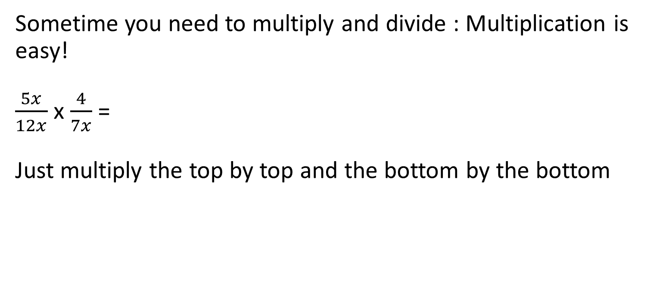
Algebraic Fractions
Sometime you need to multiply and divide : Multiplication is easy!
$\frac{5x}{12x}$ x $\frac{4}{7x}$ =
Just multiply the top by top and the bottom by the bottom

Slide 145
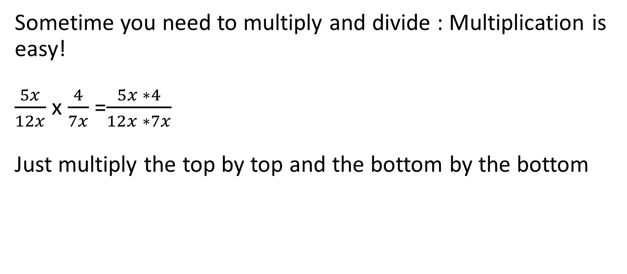
Algebraic Fractions
Sometime you need to multiply and divide : Multiplication is easy!
$\frac{5x}{12x}$ x $\frac{4}{7x}$ =$\frac{5x ∗4}{12x ∗7x}$
Just multiply the top by top and the bottom by the bottom

Slide 146
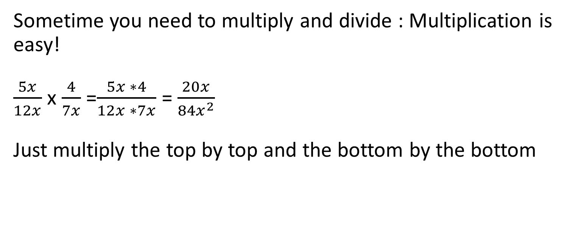
Algebraic Fractions
Sometime you need to multiply and divide : Multiplication is easy!
$\frac{5x}{12x}$ x $\frac{4}{7x}$ =$\frac{5x ∗4}{12x ∗7x}$ = $\frac{20x}{{84x}^{2}}$
Just multiply the top by top and the bottom by the bottom

Slide 147
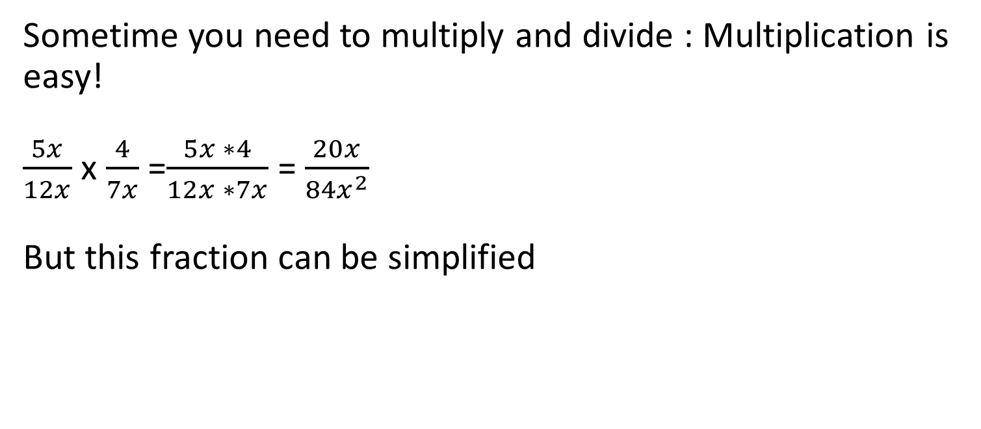
Algebraic Fractions
Sometime you need to multiply and divide : Multiplication is easy!
$\frac{5x}{12x}$ x $\frac{4}{7x}$ =$\frac{5x ∗4}{12x ∗7x}$ = $\frac{20x}{{84x}^{2}}$
But this fraction can be simplified

Slide 148
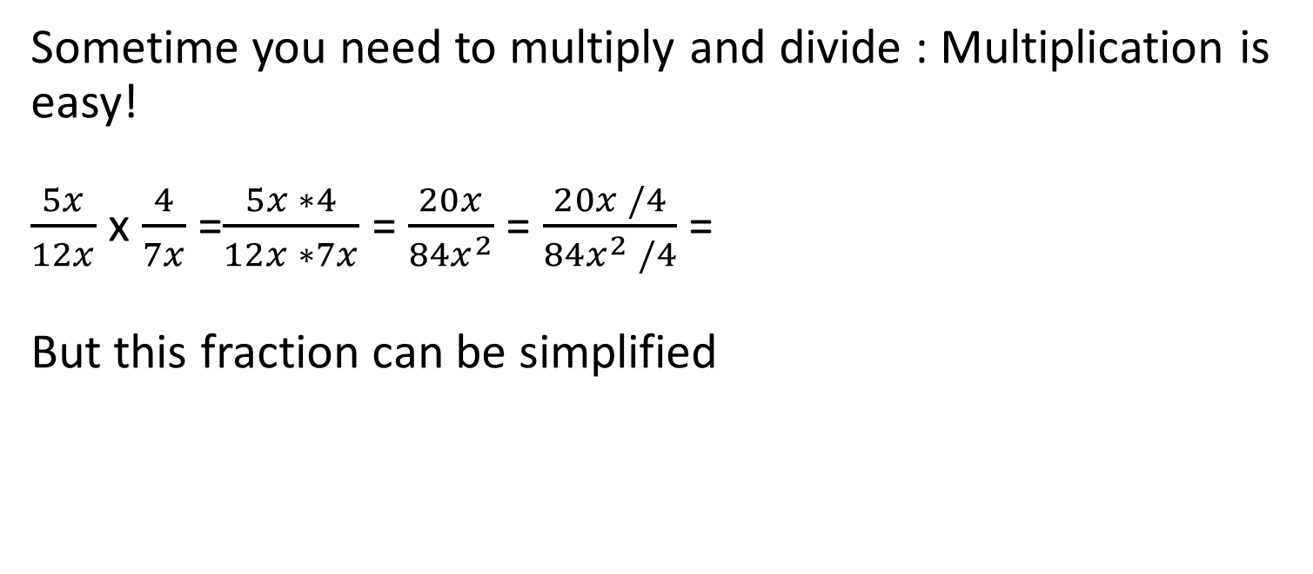
Algebraic Fractions
Sometime you need to multiply and divide : Multiplication is easy!
$\frac{5x}{12x}$ x $\frac{4}{7x}$ =$\frac{5x ∗4}{12x ∗7x}$ = $\frac{20x}{{84x}^{2}}$ = $\frac{20x /4}{{84x}^{2} /4}$ =
But this fraction can be simplified

Slide 149
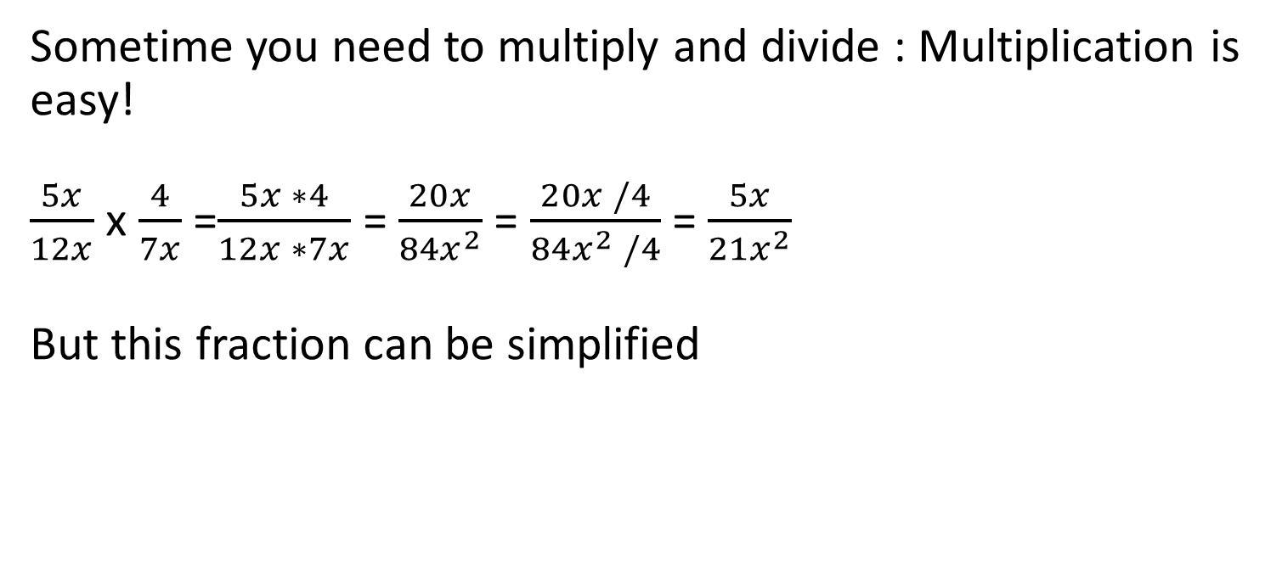
Algebraic Fractions
Sometime you need to multiply and divide : Multiplication is easy!
$\frac{5x}{12x}$ x $\frac{4}{7x}$ =$\frac{5x ∗4}{12x ∗7x}$ = $\frac{20x}{{84x}^{2}}$ = $\frac{20x /4}{{84x}^{2} /4}$ = $\frac{5x}{{21x}^{2}}$
But this fraction can be simplified

Slide 150
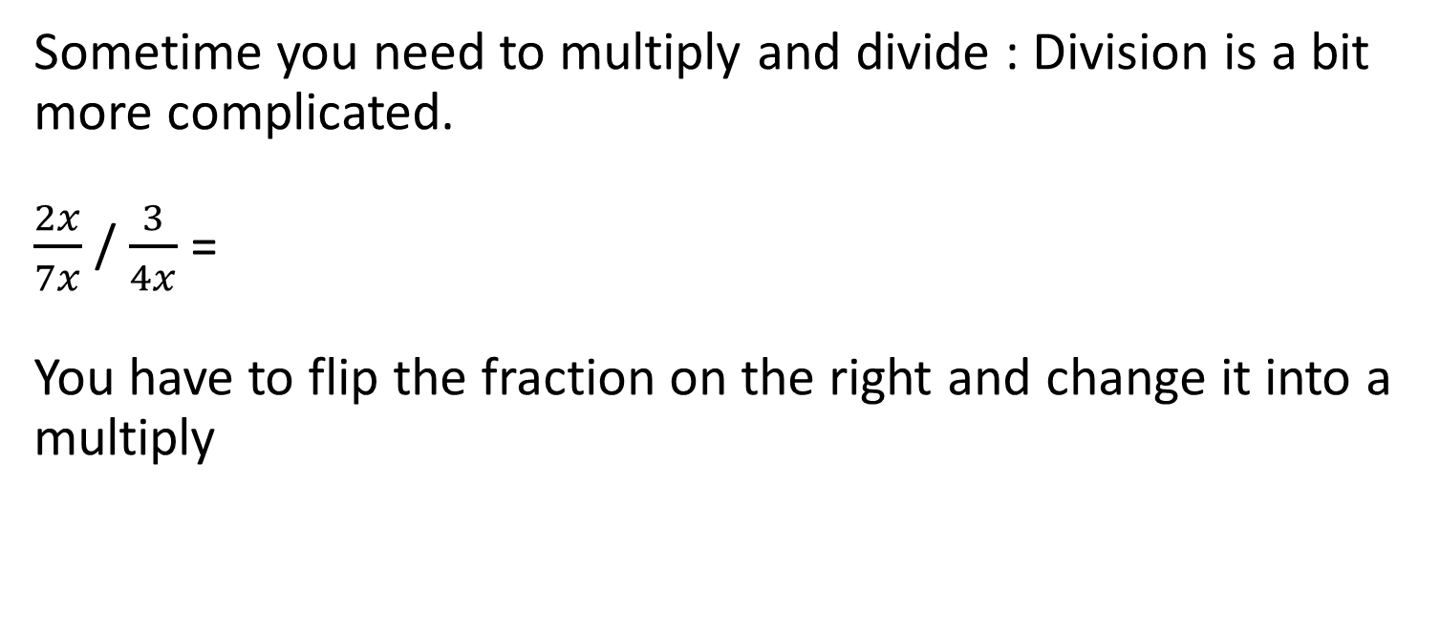
Algebraic Fractions
Sometime you need to multiply and divide : Division is a bit more complicated.
$\frac{2x}{7x}$ / $\frac{3}{4x}$ =
You have to flip the fraction on the right and change it into a multiply

Slide 151
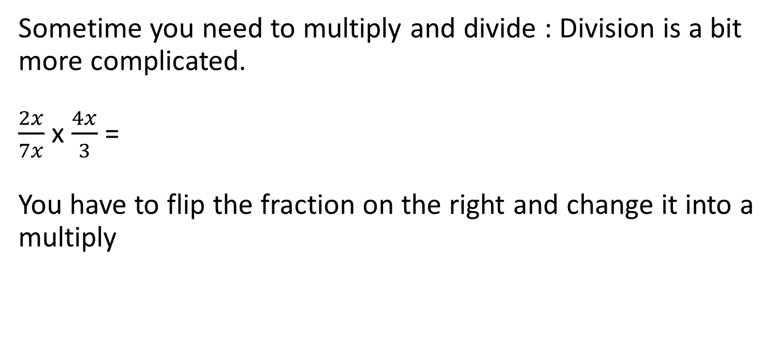
Algebraic Fractions
Sometime you need to multiply and divide : Division is a bit more complicated.
$\frac{2x}{7x}$ x $\frac{4x}{3}$ =
You have to flip the fraction on the right and change it into a multiply

Slide 152
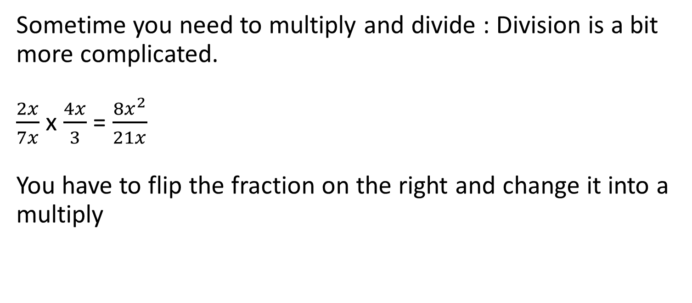
Algebraic Fractions
Sometime you need to multiply and divide : Division is a bit more complicated.
$\frac{2x}{7x}$ x $\frac{4x}{3}$ = $\frac{{8x}^{2}}{21x}$
You have to flip the fraction on the right and change it into a multiply

Slide 153
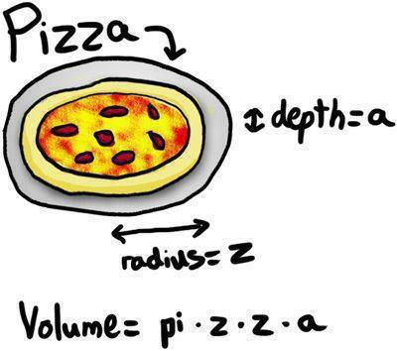
Formulae or algebra in science
In science we deal with lots of pre-established formulae
These are just algebraic expressions where we are describing concepts in science.
e=mc²
This is one of the most well known formulae in the world.

Slide 154
Formulae
Let’s look at another well known formula
f = ma
force = mass x acceleration
This is the equation for calculating the force of a moving object when you know the weight and the speed (well mass and acceleration are not the same but close enough!)
But what if we know the force and the mass but we want to know the acceleration!

Slide 155
Transposing Formulae
f = ma
f / m = ma / m
f / m = a
or a = f / m

Slide 156
Transposing Formulae
f = ma
f / m = ma / m
f / m = a
or a = f / m
Divide both sides by mass

Slide 157
Transposing Formulae
f = ma
f / m = ma / m
f / m = a
or a = f / m
Now you have an equation to work out acceleration

Slide 158
Transposing Formulae
f = ma
f / m = ma / m
f / m = a
or a = f / m
Now you have an equation to work out acceleration
But things look neater on the left!

Slide 159

Transposing Formulae
Lets try a more complicated one.
$$v=\frac{2r}{cx^{2}}$$
Make x the subject of the equation

Slide 160

Transposing Formulae
$$v=\frac{2r}{cx^{2}}$$

Slide 161

Transposing Formulae
$$v=\frac{2r}{cx^{2}}$$
Times both sides by $cx^{2}$

Slide 162

Transposing Formulae
$$vcx^{2}=2r$$

Slide 163

Transposing Formulae
$$vcx^{2}=2r$$
Divide both sides by vc

Slide 164

Transposing Formulae
$$x^{2}=\frac{2r}{vc}$$
Divide both sides by vc

Slide 165

Transposing Formulae
$$x^{2}=\frac{2r}{vc}$$

Slide 166

Transposing Formulae
$$x^{2}=\frac{2r}{vc}$$
Square root both sides

Slide 167

Transposing Formulae
$$√x^{2}=√\frac{2r}{vc}$$
Square root both sides

Slide 168

Transposing Formulae
x$=√\frac{2r}{vc}$
And done

Slide 169
Problems
Time to practice on your own:

